Slide 1
07 | Scaling Your Application Under Load
James Chambers | @CanadianJames
Simon Timms | @stimms

Slide 2
Module Overview
Please leave this area blank to allow for picture in picture recording
Horizontal vs Vertical Scaling
Architecture Concerns
Stress Testing to Find Bottlenecks

Slide 3
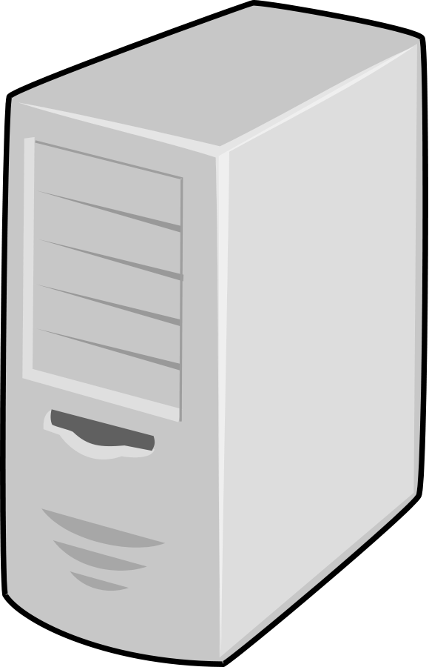

Theories of Scale – Vertical
Please leave this area blank to allow for picture in picture recording
Big apps need big power
Simplified architecture
Hard disks are cheap
Processors are cheap

Slide 4
Theories of Scale – Horizontal
Please leave this area blank to allow for picture in picture recording
Small tasks need little power
Well-architected services remain simple
Only pay for storage when you need it
Only pay for processing time you use

Slide 5
Some Assembly Required
Please leave this area blank to allow for picture in picture recording
Cloud is an enabler for scalability
Your architecture needs to support it
Lift & shift not supported

Slide 6
?

Slide 7
Why Perform Load Testing?
Please leave this area blank to allow for picture in picture recording
Exposes application bottlenecks
Proves architectural decisions
Identifies regional issues and operational insights
Repeatable
It’s not as hard as it used to be!
Notes:
Not hard:
- don’t have to set up a lab/infrastructure
- samples to get you started

Slide 8
To the Cloud!
Please leave this area blank to allow for picture in picture recording

Slide 9
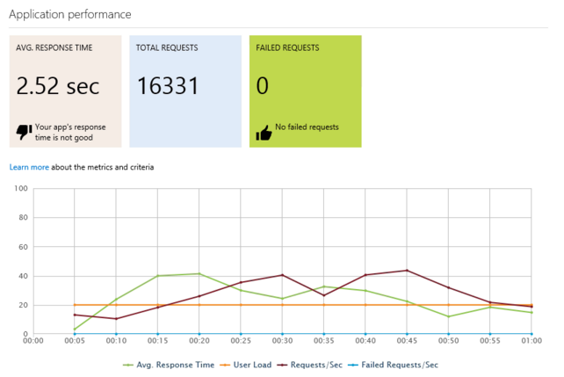
Concerns, Best Practices, Tips
Better tests = better data
Focus on the pieces where latency is a concern
Use load test results as a deployment gate

